Slide 1

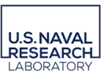
Lightweight Seal Plates and Quick Connect Snoots for Fast Delay Lines at the Navy Precision Optical Interferometer
Team Members:
Bradley Kingsley
Dustin Haines
Trung Son Nguyen
Notes:
NPOI Capstone is sponsored by the Navy Research Lab and the Navy precision Optical Interferometer.

Slide 2
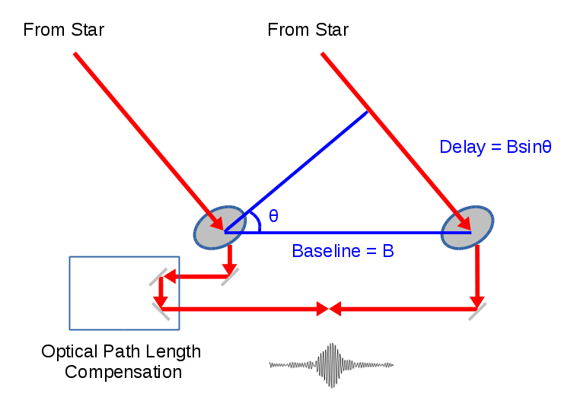
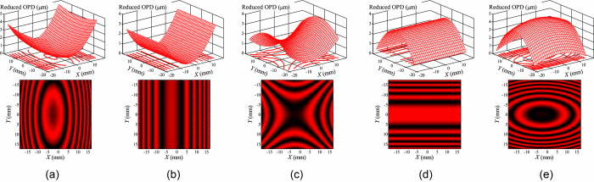
What is an "Interferometer"?
Synthesize a large mirror by using multiple smaller telescopes spread out.
Delay the light to keep the photons in phase and ensure path length is within a few nanometers.
Vacuum is used to reduce atmospheric disturbance in the wavefront.

Slide 3

Sponsor Information and Importance
Jim Clark, Director and Chief Engineer
Naval Research Lab/NPOI
Importance:
  Reduce Observation Down Time
  Continuing Observations Nightly
  Ease Technician Large Equipment Use
  Reduce Required Technician Quantity for Disassembly

Slide 4
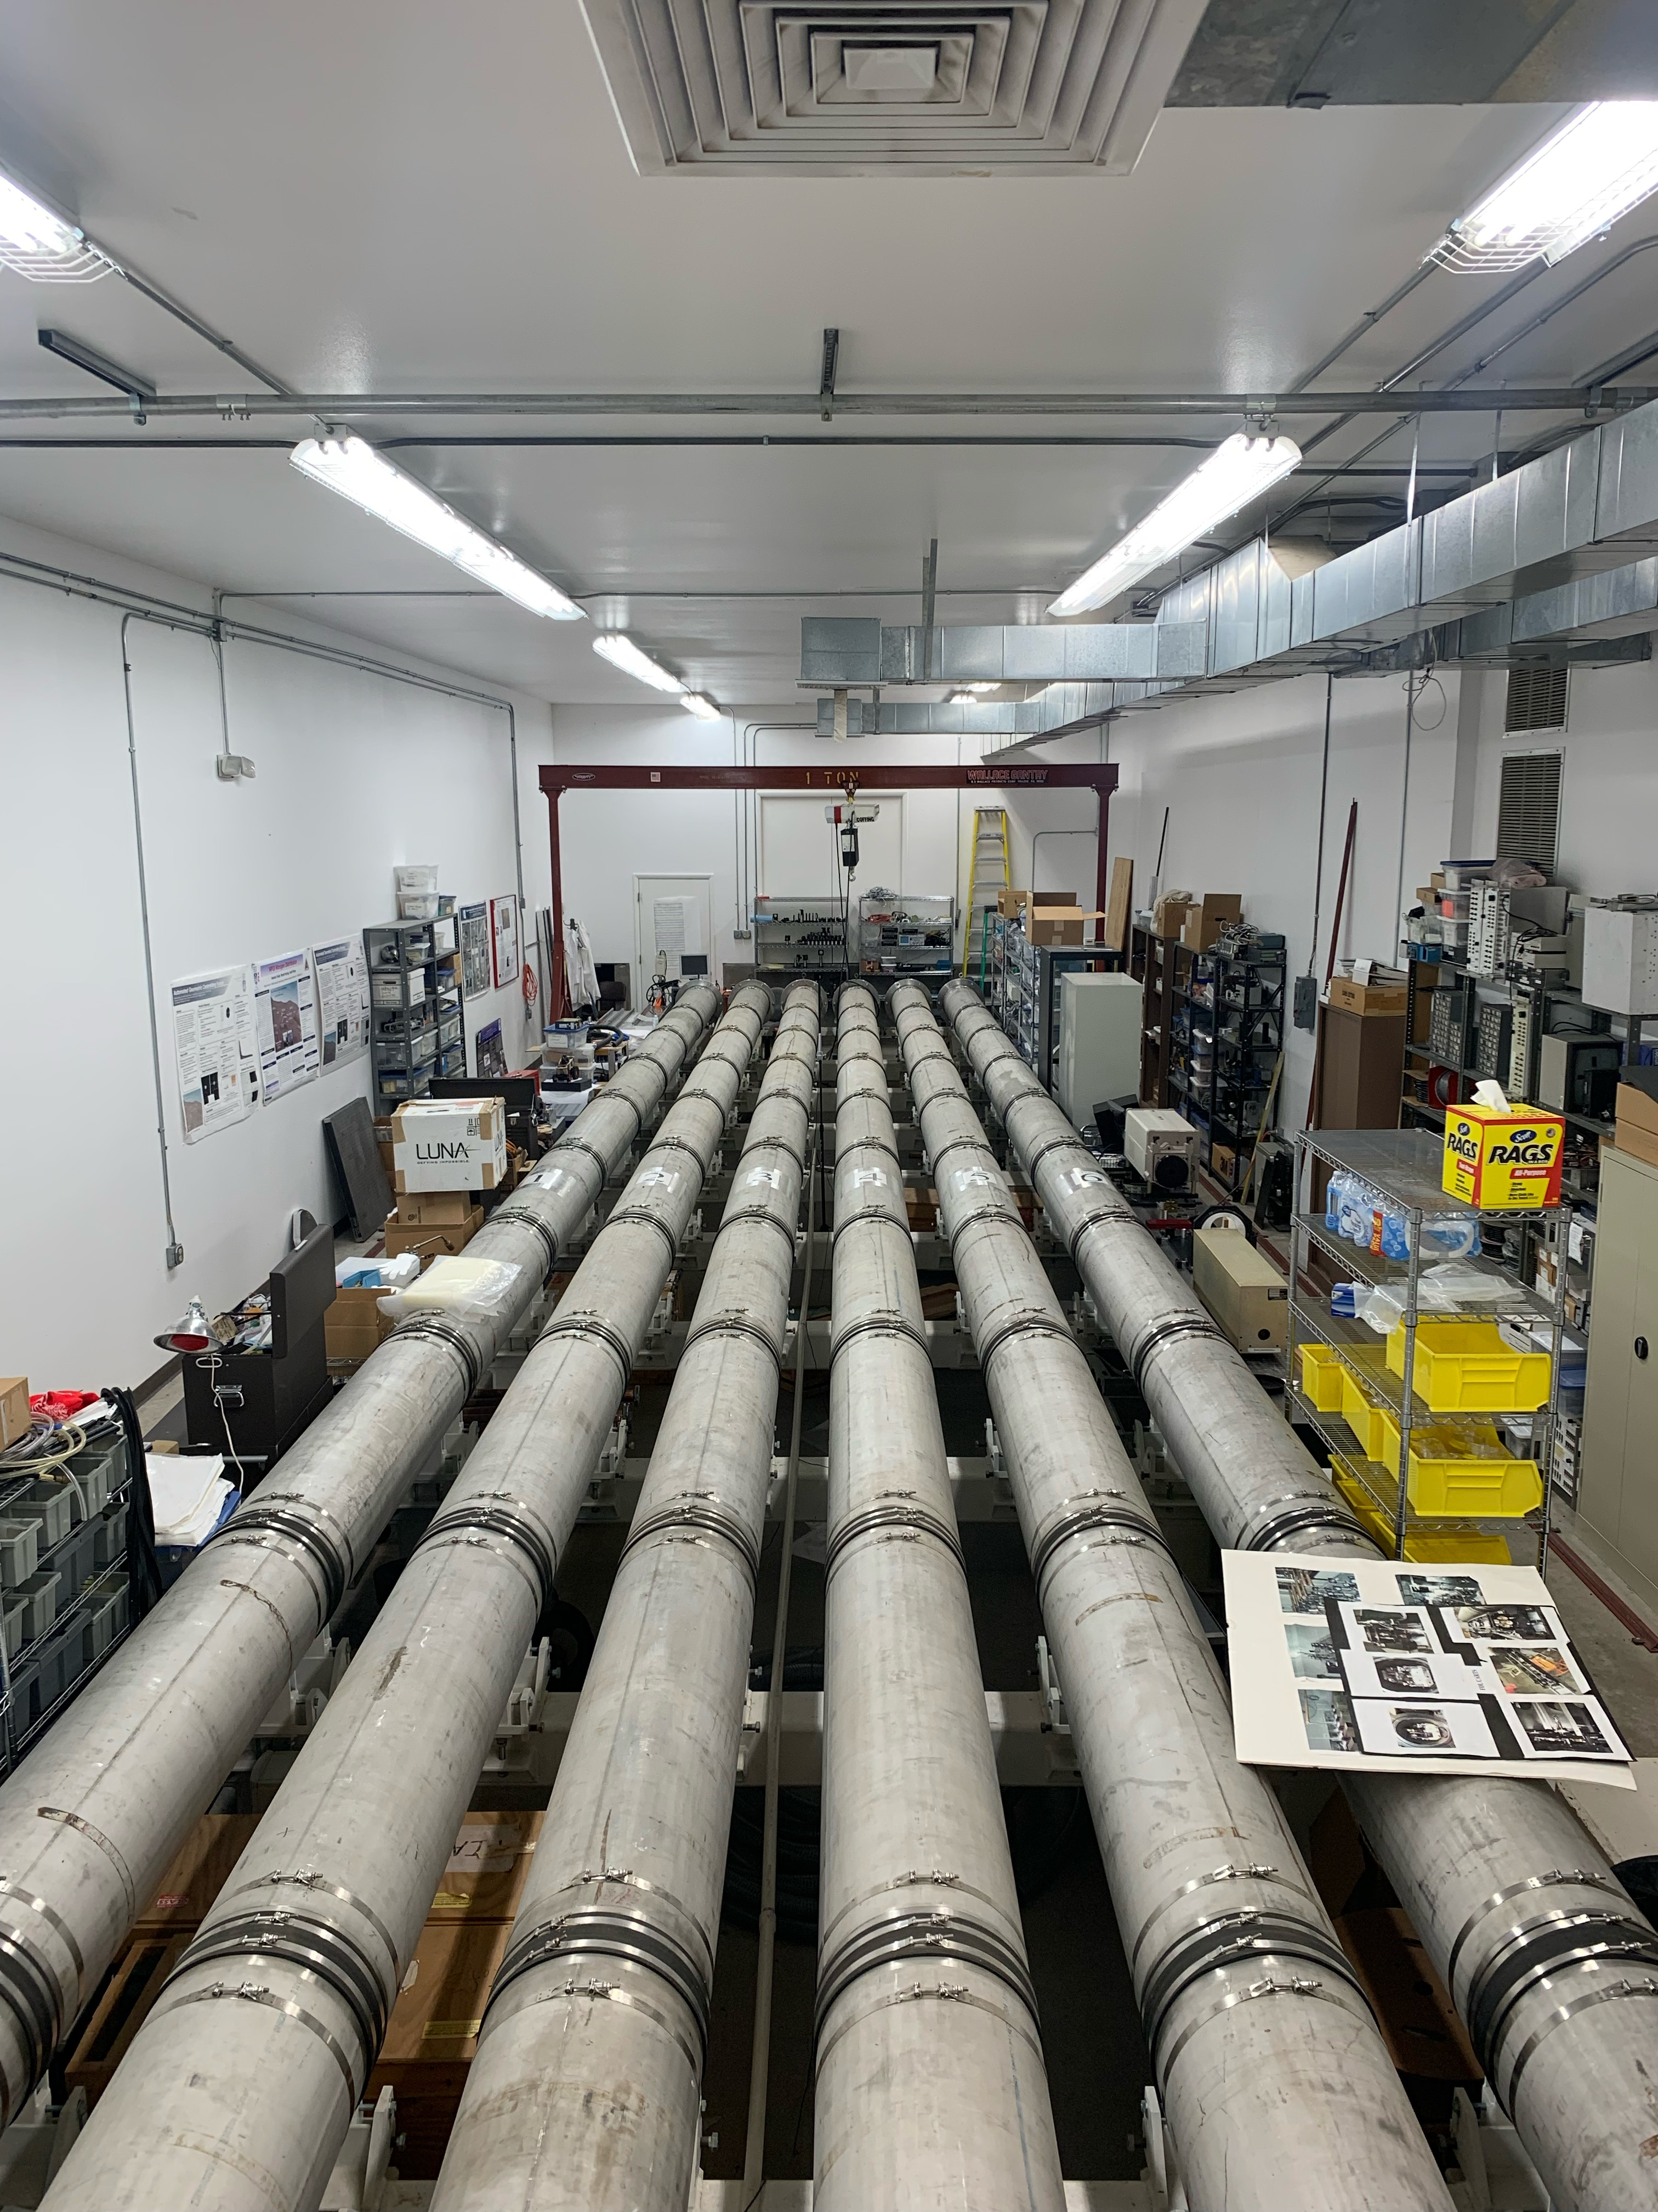
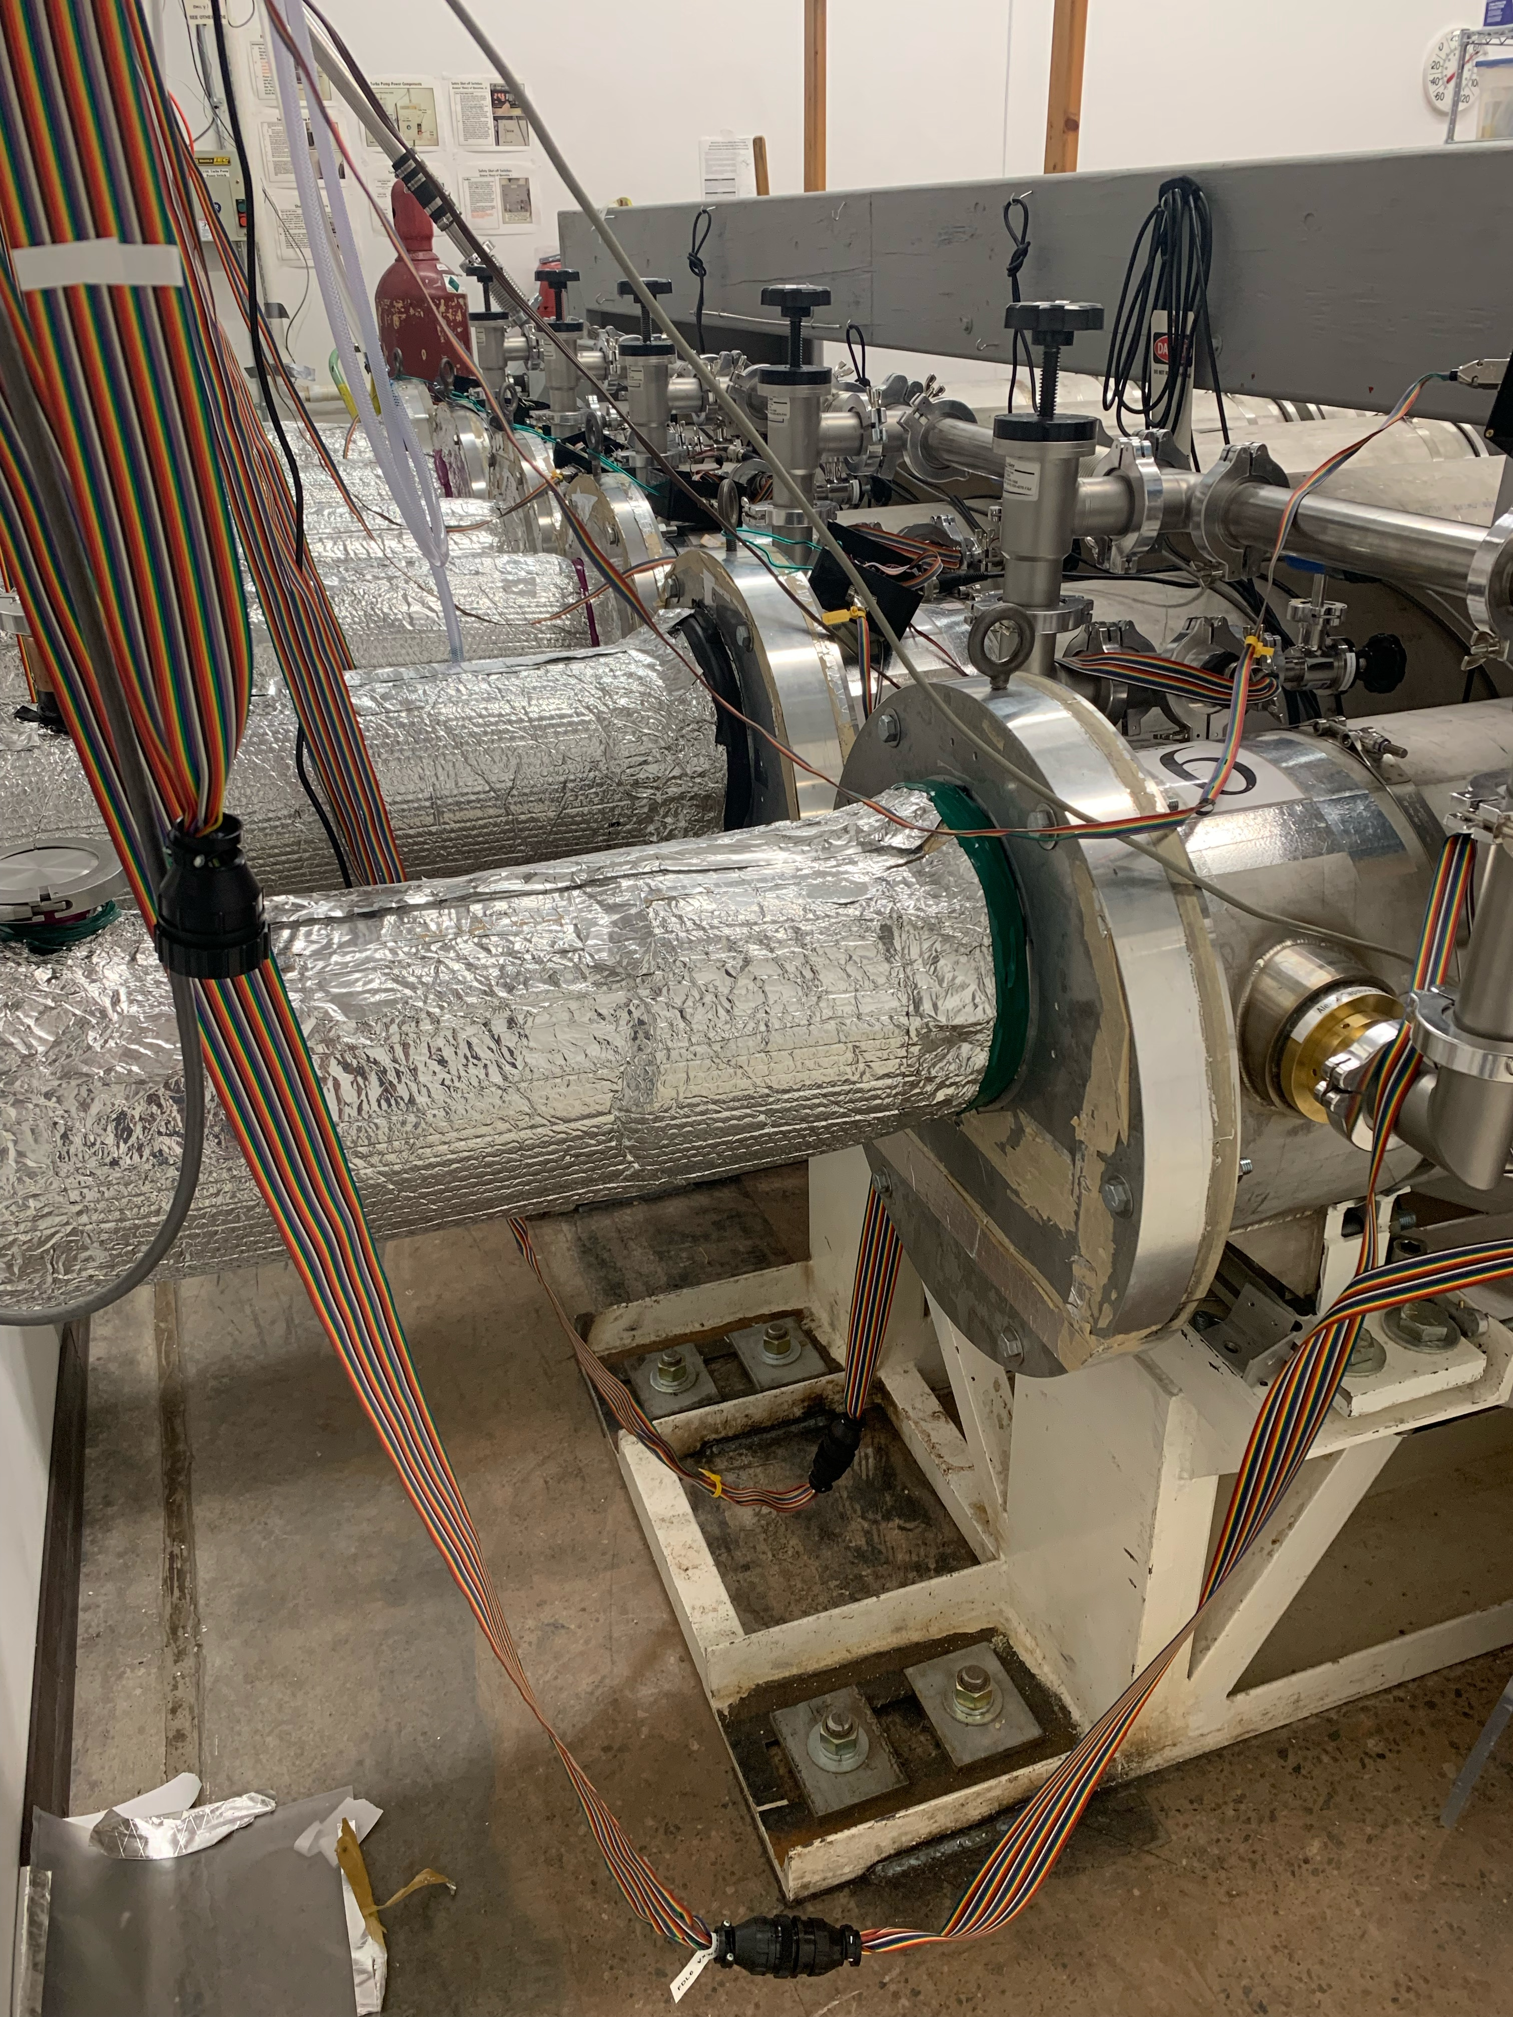
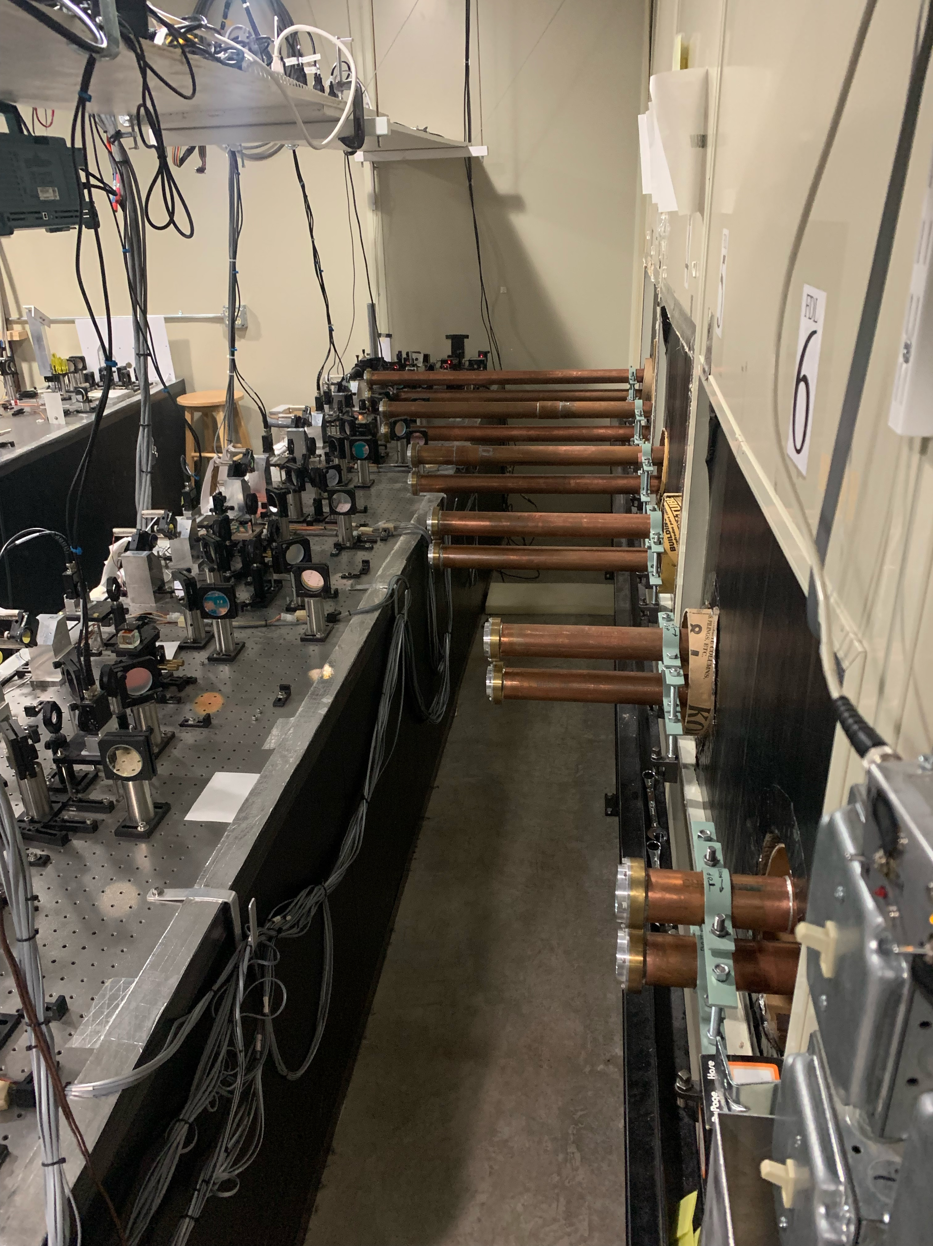
NPOI Capstone Project Description
Design Front & Rear Seal Plates (with sight Ports)
Custom Quick Connect Snoot Design (Metrology & Stellar Light)
Custom Snoot Adjustable Fixture

Slide 5
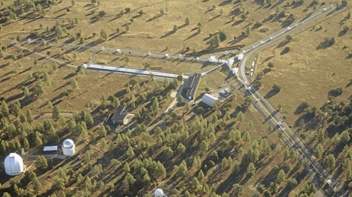
State-of-the-Art
Longest baselines of any optical interferometer in the world
Highest angular resolution
  Faint objects
  Single stars
  Double stars
  Etc.
NPOI Site, Flagstaff, AZ (Photo Courtesy of Michael Collier)
Dustin_09/20/22_NPOI Capstone_P5

Slide 6
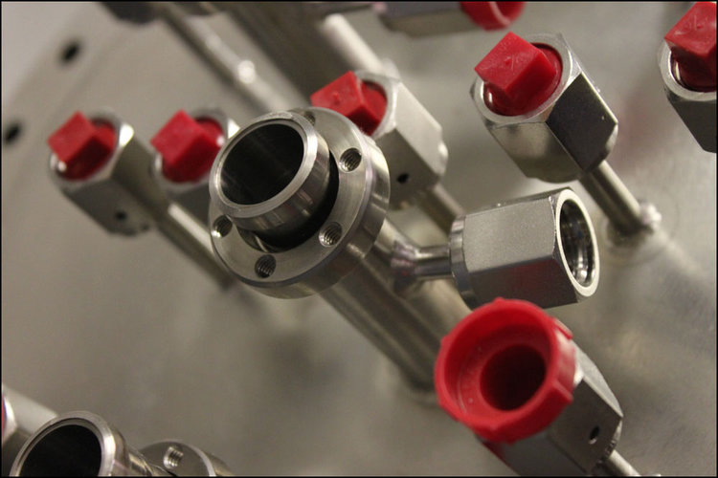
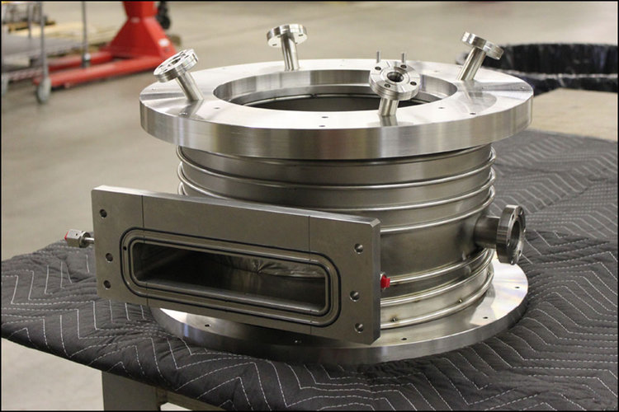
Background & Benchmarking
Imperial Machine & Tool CO. Vacuum Chambers
  Laser and energy beam precision angular features and intersection points aka sight-ports
  Cooling shrouds, gas injectors, showerheads, etc.
https://images.squarespace-cdn.com/content/v1/575ac3f6356fb0c38fb63b52/1476748854370-8MVJ32W2BGA4MDHKZ1LQ/image-asset.jpeg?format=750w
https://images.squarespace-cdn.com/content/v1/575ac3f6356fb0c38fb63b52/1476747741859-WZHBUPZ94JFKK3CUTQMN/image-asset.jpeg?format=750w

Slide 7
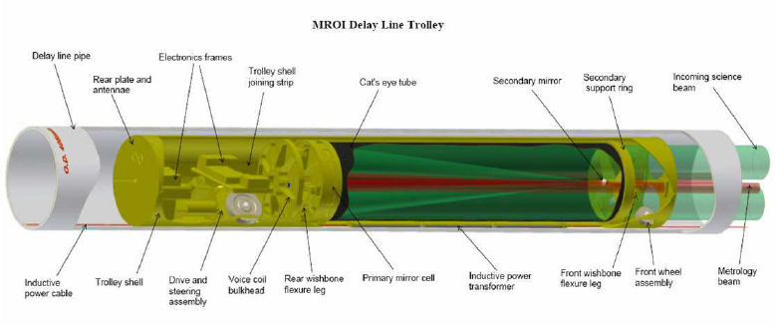
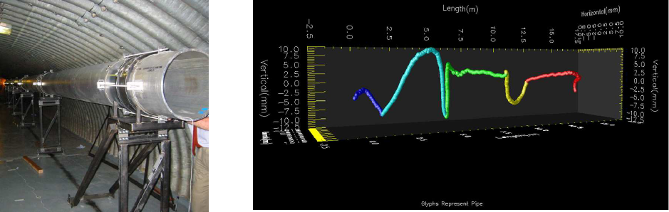
Background Cont.
Long-stroke MROI Vacuum Delay lines
  Aluminum pipe: good heat dissipation
  Aluminum and polymer connecters: good suction, predicted system re-pumping once a week
  Difference of < 10 ηm
https://www.researchgate.net/profile/David-Buscher-2/publication/237371110/viewer/AS:114917705261056@1404409924288/background/4.png
https://www.researchgate.net/profile/David-Buscher-2/publication/237371110/viewer/AS:114917705261056@1404409924288/background/7.png

Slide 8
Literature Review
The Importance of Choosing the Correct Material for Vacuum O-Rings and Vacuum Seals.
Alignment of Vacuum Feed Stations on the Navy Prototype Optical Interferometer
Imperial Machine & Tool Company
Different materials have different outcomes for permeability for air and seal's deformation. The team can decide the material used to satisfy customers' need.
The clients need the seal of vacuum tank in good alignment and this source will help the team to during the set-up of the vacuum seal.
The company has years of experience about making vacuum optical equipment. The team can ask for their help when manufacturing a real seal plate for vacuum tanks.

Slide 9
Customer Needs Engineering Requirements
Less Than 35 lbs.
Disassembly < 1 Hour
Seals tanks in ATM and in Vacuum (Torr)
Drift < 0.001 in/month
Deformation < 0.010 in
X,Y, adjustment ±0.5 in
At least 2 sight Ports
Lightweight
User/technician Friendly
Seal to Vacuum
Stable Alignment
Small Deformation
Adjustable Frame
Sight Ports

Slide 10
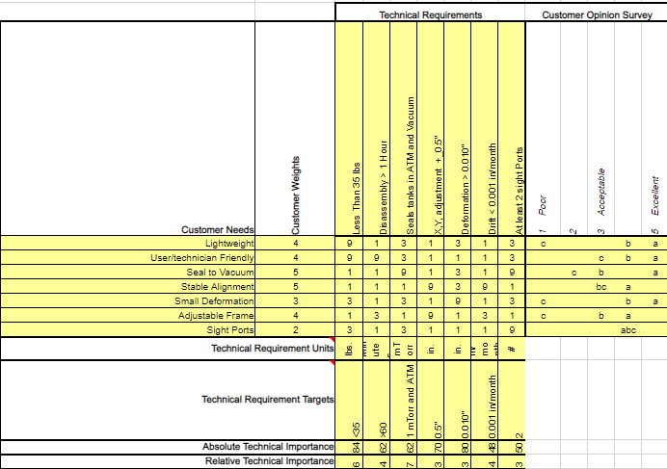
QFD (House of Quality)

Slide 11
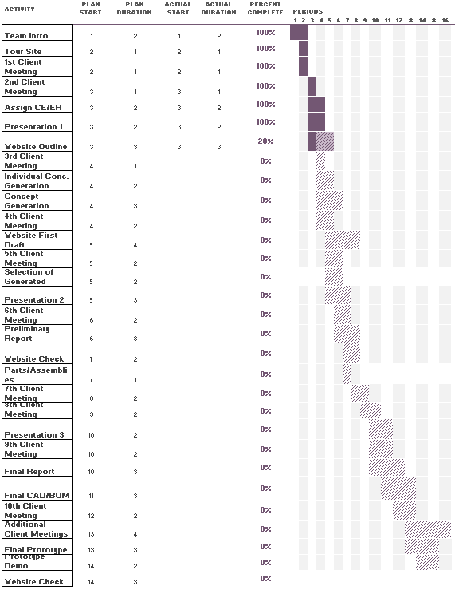
Schedule
Currently on schedule
At least 10 client meetings throughout first semester
Starting working one week before deadlines

Slide 12
Costing Analysis
Total Budget: $9,500
NPOI Capstone Costing:
Section: |  | Cost Per: | Quantity: | Equate:
Front Seal Plate |  | 600 | 6 | 3600
Rear Seal Plate |  | 600 | 6 | 3600
Metrology Snoots: |  | 70 | 12 | 840
Stellar Snoots: |  | 70 | 12 | 840
Feed Through: |  | 20 | 6 | 120
Snoot Adjuster: |  | 75 | 6 | 450
 |  |  | Sum= | 9450
 |  | Total Project Budget: |  | 9500

Slide 13
Cite Sources
1. 'The Importance of Choosing the Correct Material for Vacuum O-Rings and Vacuum Seals'. Apple Rubber. [OnlineAccess]. https://www.applerubber.com/hot-topics-for-engineers/the-importance-of-the-correct-material-for-vacuum-o-rings-and-vacuum-seals/
2. J.A. Clark III , J. Murphy, L. Ha, J. P. Walton , J. Howard, J. T. Armstrong, G. C. Gilbreath , R. B. Hindsley , and T. A. Pauls. 'Alignment of vacuum feed stations on the Navy Prototype Optical Interferometer'. [OnlineAccess]. https://apps.dtic.mil/sti/pdfs/ADA477246.pdf
3. 'Vacuum Chambers and Optical Equipment'. Imperial Machine & Tool CO. [OnlineAccess]. https://www.imperialmachine.com/vacuum-chambers
4. 'The long-stroke MROI vacuum delay lines from concept to generation' [OnlineAccess]. https://www.researchgate.net/publication/237371110_The_long-stroke_MROI_vacuum_delay_lines_from_concept_to_production

